Slide 1
Biomedical Imaging X-Ray Imaging (III)
Sebastian Kozerke
Institute for Biomedical Engineering, University and ETH Zurich, Switzerland

Slide 2
Today’s Learning Objectives
Recap FT and FPB reconstruction in reciprocal spaces
Relate FT and FBP reconstruction to algebraic reconstruction
Explain spiral CT principle and reconstruction
Derive relation between SNR and experimental settings
Implement noisy CT experiment and filtering (Exercise)

Slide 3
Image reconstruction

Slide 4
CT – Image reconstruction
Inverse transform (III)
F{Filter}
Filter ?
Notes:
Blackboard
-> Calculate FT of |u|

Slide 5
CT – Image reconstruction
F{Filter}
Filter
|u|⋅rect(1/Δr)
∝ 1/r²
u
r
Δu=1/Δr
Δr
“Ramachandran & Lakshminarayanan”
=“Ram-Lak”

Slide 6
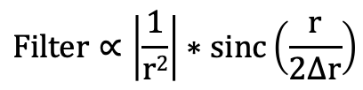
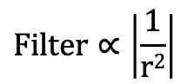
CT – Filter
Point object
Image
Object
Projections
“Ideal” Filter: 1) radius_{object} → 0
2) number of projections → ∞
3) number samples per projection → ∞
$$Filter∝\left|\frac{1}{r2}\right|$$
Ram-Lak Filter
“Real” Filter: 1) radius_{object} → 0
2) number of projections → ∞
3) number samples per projection → N_{r}
$$Filter∝\left|\frac{1}{r2}\right|∗sinc\left(\frac{r}{2∆r}\right)$$

Slide 7
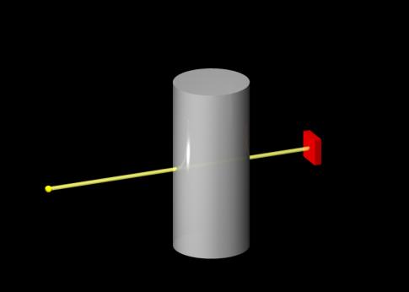
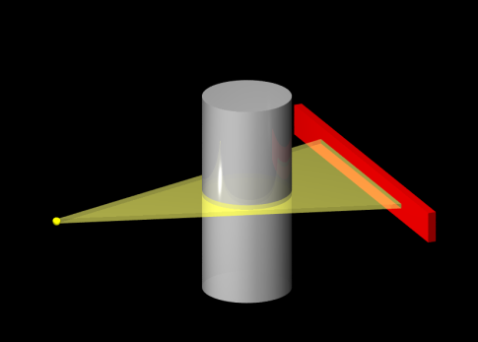
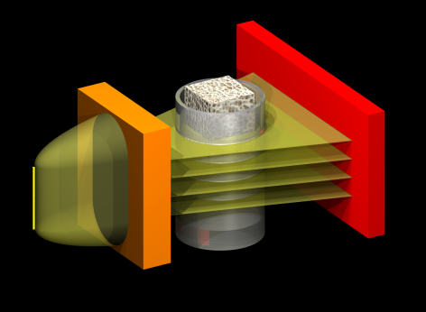
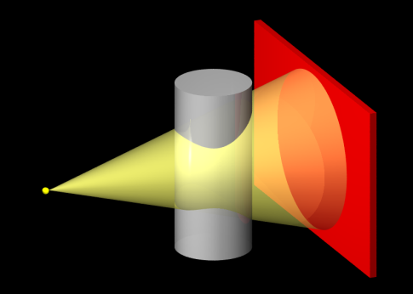
CT – Beam geometries
Scan efficiency
Image reconstruction complexity

Slide 8
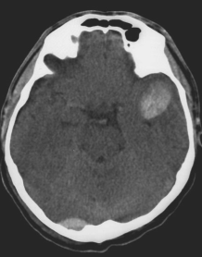
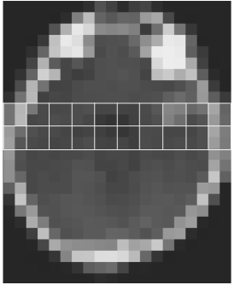
CT – General approaches to reconstruction
Recon Object O(x,y) Measurement Measured data P(ϕ,r)
Analytical continuous continuous continuous
Algebraic discrete linear discrete
Notes:
Blackboard
-> Analytical: a) draw continuous attenuation profile through head; b) draw continuous projection
-> Algebraic: a) draw discrete attenuation profile; b) draw discrete projection value; Measurement: P = M⋅O+n -> Reconstruction: O=M⁻¹P (exact solution) -> O=M⁺P (best solution in a least-squares sense).

Slide 9
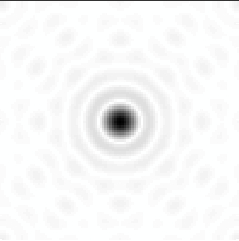


Clicker Activity (5 min)
How many projections does one need to collect in order to fulfill the Nyquist sampling criterion if the number of sample points per projection is N according to the Nyquist rate Δq?
• N different projections are required
• 2*N different projections are required
• pi/2*N different projections are required
• pi*N different projections are required
?
q
Dq
p

Slide 10
Clicker Activity (Notes)
q
Dq
Dq
p
Dp
N x N data points
p/2 x N x N data points
= p/2 x N projections

Slide 11
Chapter 2.12.1-2
Spiral CT

Slide 12
Spiral CT

Slide 13
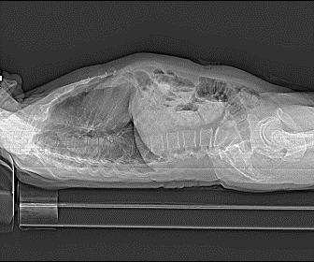
Spiral CT
X-ray tube
Detector

Slide 14
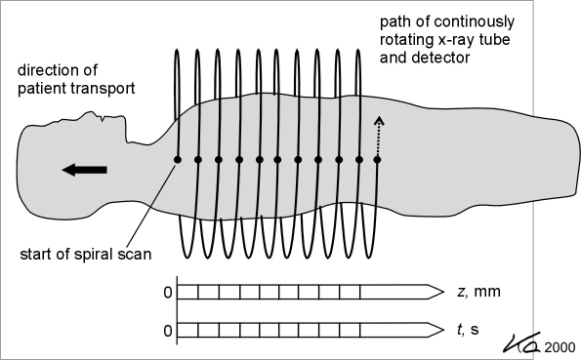
Spiral CT
Adapted from Kalender WA, Computed Tomography, ISBN 3-89578-216-5

Slide 15
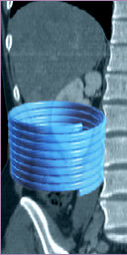
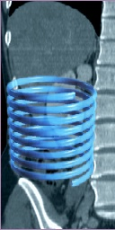
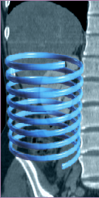
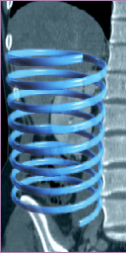
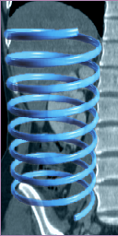
Spiral CT
Pitch - Single Slice Spiral
Pitch = table movement per rotation/slice collimation
Pitch = 1
Pitch = 1.5
Pitch = 2
Pitch = 2.5
Pitch = 3

Slide 16
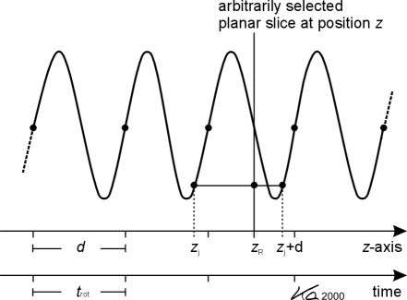
Spiral CT
Adapted from Kalender WA, Computed Tomography, ISBN 3-89578-216-5
Notes:
Blackboard
->
-> P_{z} = (1-w)P_{j}+wP_{j+d} w=(z_{R}-z_{j})/d

Slide 17
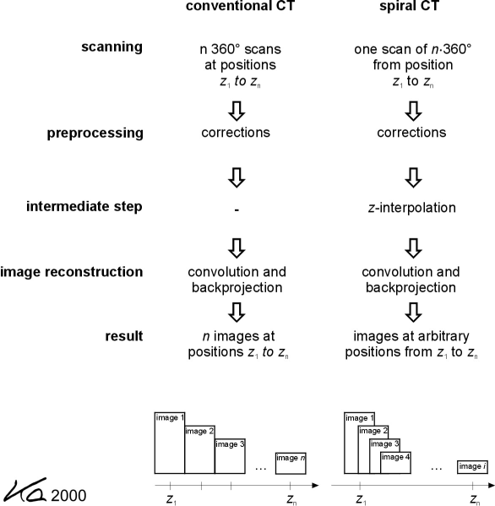
Spiral CT
Conventional CT
Spiral CT
Adapted from Kalender WA, Computed Tomography, ISBN 3-89578-216-5

Slide 18
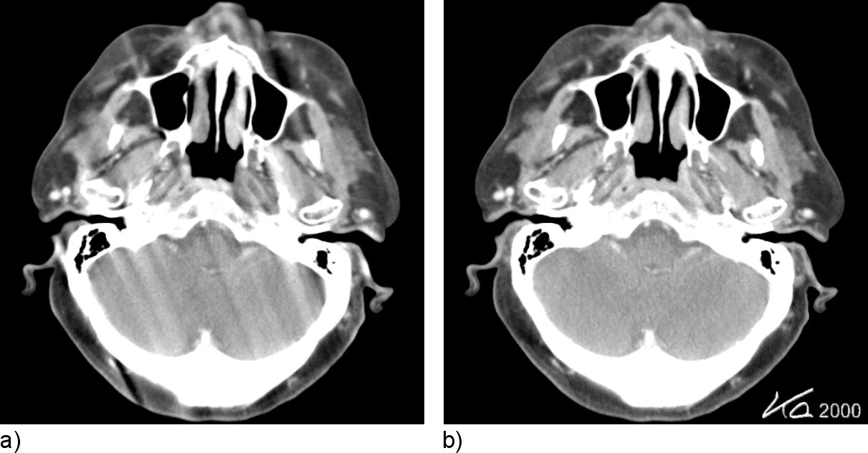
Spiral CT
Without z-Interpolation
With z-Interpolation
Adapted from Kalender WA, Computed Tomography, ISBN 3-89578-216-5

Slide 19
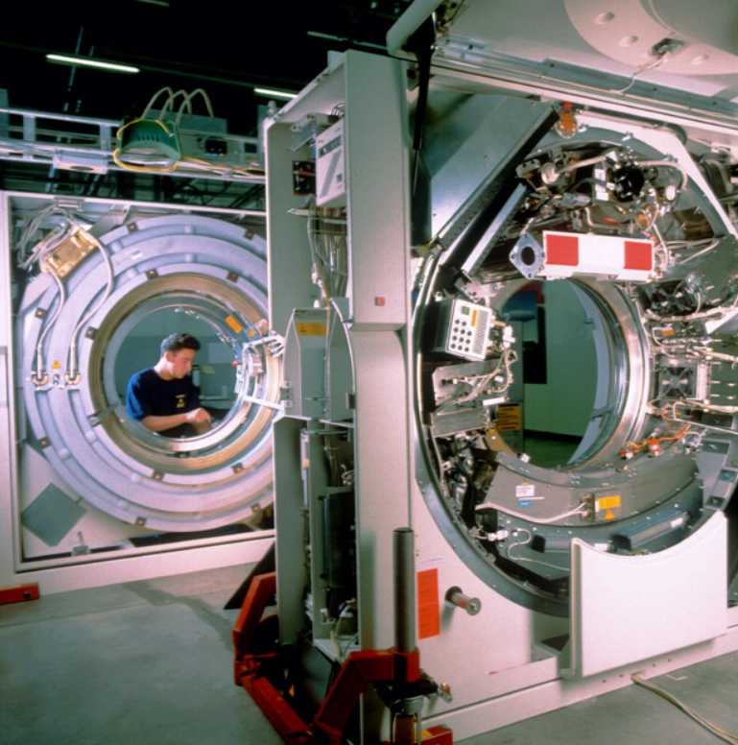
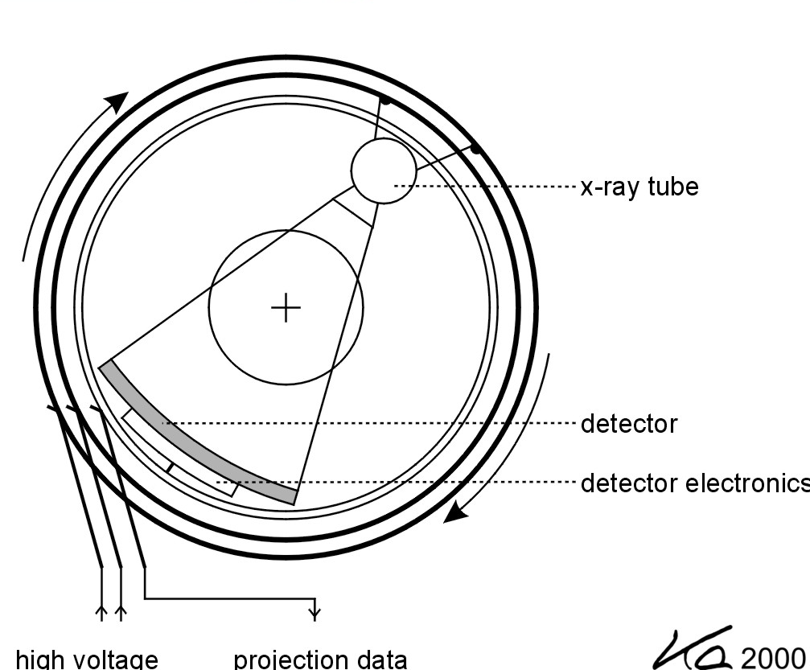
Multi-slice CT
single detector
multi detector
z

Slide 20
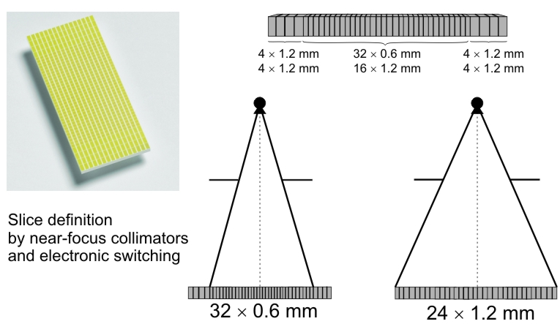
Multi-slice CT
Adapted from Kalender WA, Computed Tomography, ISBN 3-89578-216-5

Slide 21
Multi-slice CT

Slide 22
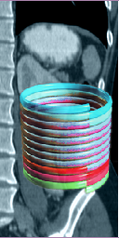
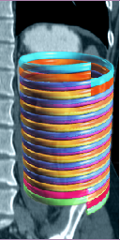
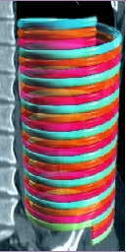
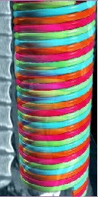
Multidetector/Multislice Spiral CT
Pitch - Single Slice Spiral
Pitch = table movement per rotation/slice collimation
Pitch = 1
Pitch = 2
Pitch = 3
Pitch = 4

Slide 23
Chapter 2.18
Applications

Slide 24
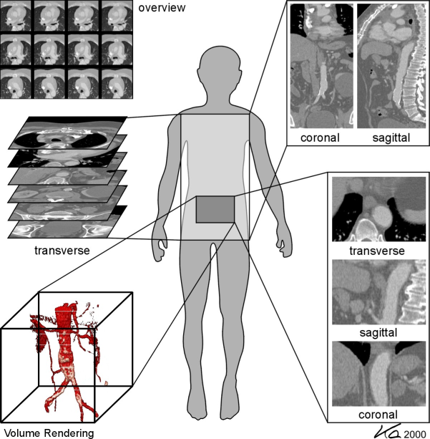
CT – Applications
From Kalender WA, Computed Tomography, ISBN 3-89578-216-5

Slide 25
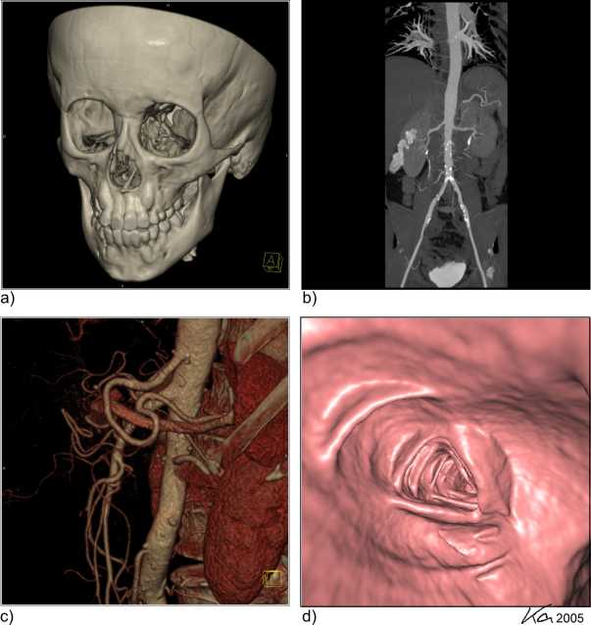
CT – Applications

Slide 26
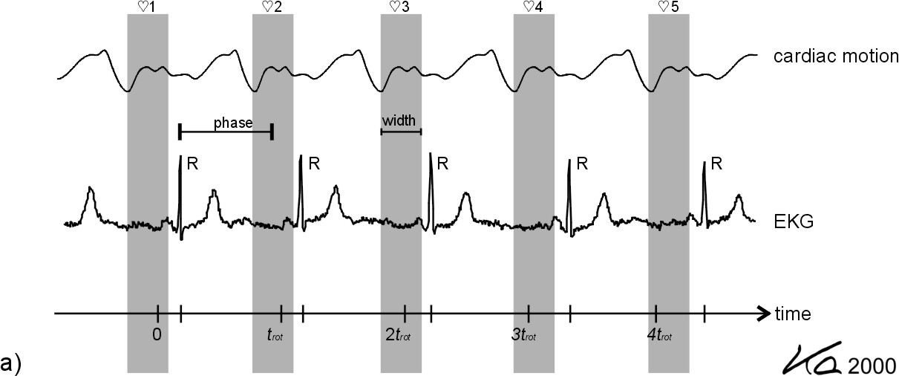
CT – Applications
From Kalender WA, Computed Tomography, ISBN 3-89578-216-5

Slide 27
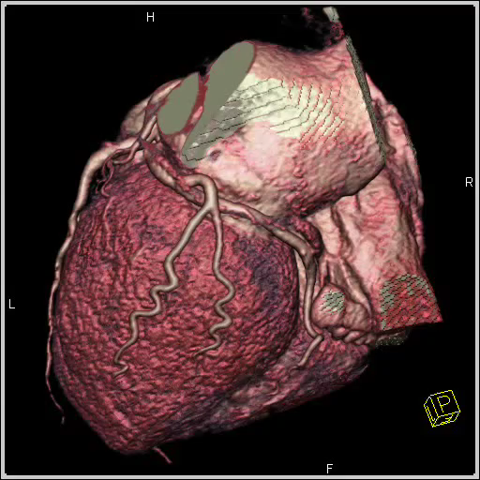
CT – Applications
From Kalender WA, Computed Tomography, ISBN 3-89578-216-5

Slide 28
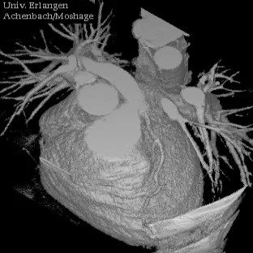
CT – Applications
From Kalender WA, Computed Tomography, ISBN 3-89578-216-5

Slide 29
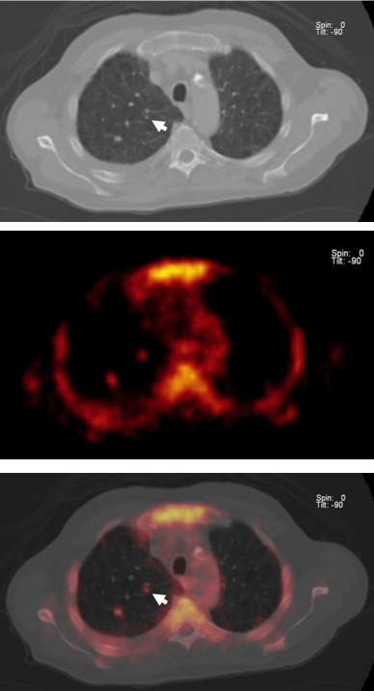
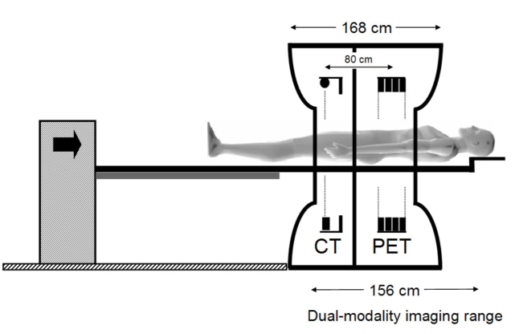
CT – PET
CT
PET
Fusion
From Kalender WA, Computed Tomography, ISBN 3-89578-216-5

Slide 30
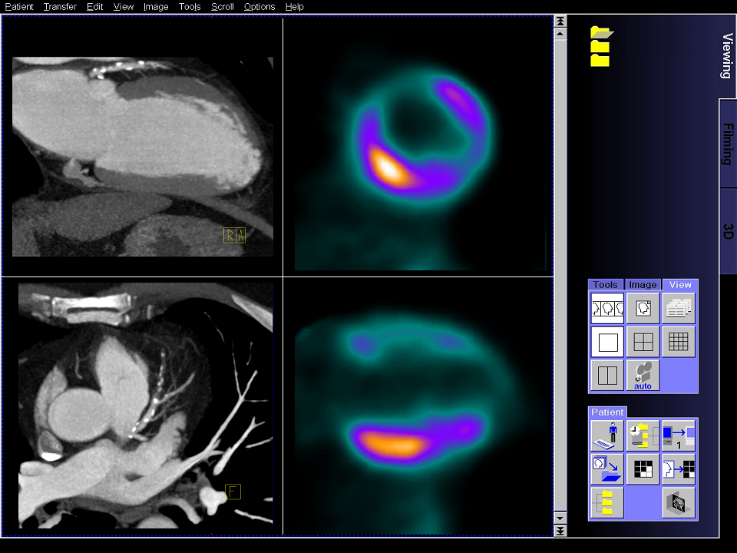
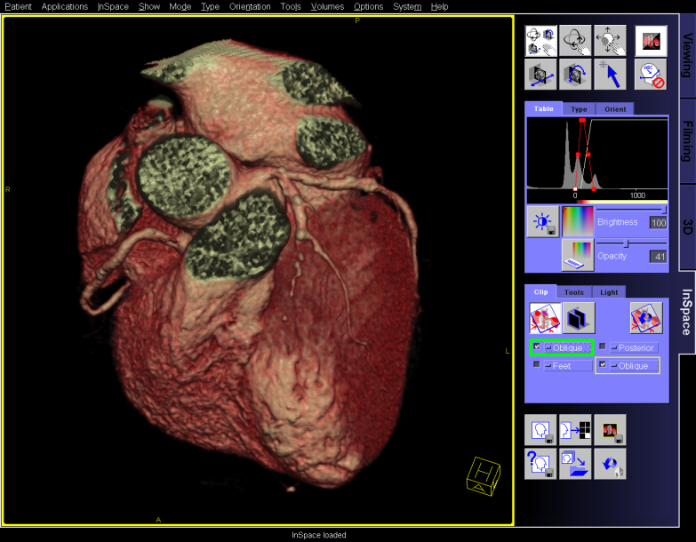
CT – PET
CT
PET

Slide 31
Chapter 1.4-1.6, 2.8
Image quality

Slide 32
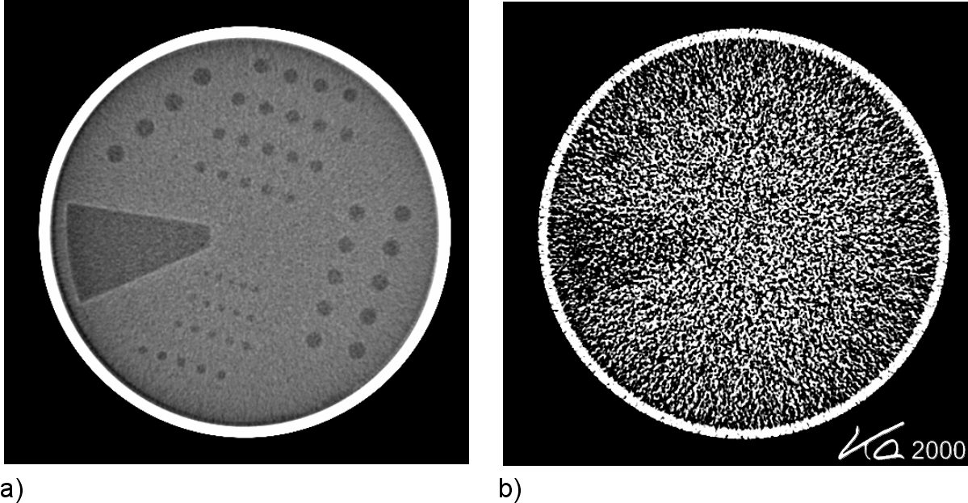
Image quality
High-dose scan (e.g. brain)
Low-dose scan (e.g. bone)

Slide 33
Image quality
“spatial blurring”
“uncertainty”
Quantum noise (→ Poisson distribution):
: mean number of x-ray quanta registered by detector
Notes:
Blackboard
-> C(E) = energy-dependent contrast factor taking into account x-ray beam energy, filtration, detector type
-> artifacts = coherent patterns
Notes
In probability theory and statistics, the Poisson distribution is a discrete probability distribution. It expresses the probability of a number of events occurring in a fixed period of time if these events occur with a known average rate, and are independent of the time since the last event.
The distribution was discovered by Siméon-Denis Poisson (1781–1840) and published, together with his probability theory, in 1838 in his work Recherches sur la probabilité des jugements en matières criminelles et matière civile ("Research on the Probability of Judgments in Criminal and Civil Matters"). The work focused on certain random variables N that count, among other things, a number of discrete occurrences (sometimes called "arrivals") that take place during a time-interval of given length.

Slide 34
Image noise
region-of-interest (ROI)
Pixel noise:
Q: Tube current * scan time; Δz: detector thickness
Notes:
Blackboard
->

Slide 35
Chapter 2.17
Dose

Slide 36
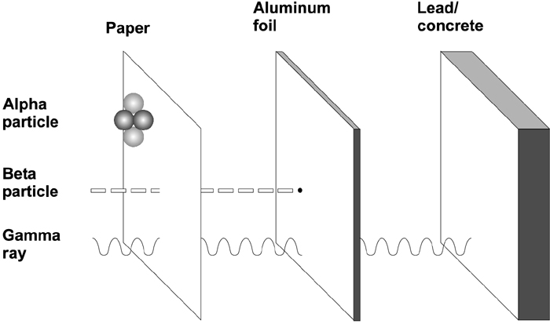
Radiation basics
Notes:
Ionizing radiation includes those types of radiation that have enough energy to knock electrons out of their orbits around atoms.
Alpha particles are identical to the nucleus of a helium atom, with two protons and two neutrons. These are destructive but they cannot pass easily through most forms of matter.
Beta particles are electrons. They can pass through some material.
Gamma rays are identical to photons, packets of light energy. These can pass through most forms of matter.
When radioactive atoms (for example iodine-131) decay, they release one or more of these forms of radiation. Each radionuclide release different types of radiation at different energies.

Slide 37
Radiation basics
Several reaction mechanisms of cell if hit by radiation:
Cell repair
Interaction with nearby cells (bystander effect)
Genomic instability
Cell death
Cells that grow out of control become cancers
Non-cancer effects of radiation include blood disorders, circulatory problems, liver disease, thyroid disease, others
Notes:
When cells are affected by radiation a network of enzymes begin to change the behavior of the cell. The cell may slow down the cycle of cell division in order to conduct surveillance for damage, it may kill itself if the damage is too great, and it may repair the damage. This repair is not perfect, and misrepair of damage can leave a cell to divide with mutations, passing these mutations on to daughter cells.
The repair machinery may be activated for an extended period of time, perhaps the cell is being ‘cautious’ in case future exposures occur. It has been observed that the damage from a large dose of radiation is sometimes less if a small dose of radiation is given some time before the large dose. The small dose is thought to make the cell ‘adapted’ to radiation and this effect is known as ‘adaptive response’. It is known to depend on the size of the first small dose and the length of time between doses, and the implications for carcinogenesis are not clear.
Bystander effects and genomic instability are thought to ‘saturate’ at low doses- in other words, the effect increases to a point and then remains constant at higher doses. This has been suggested as one reason why the dose-response curve could be nonlinear (supralinear) at low doses.

Slide 38
Radiation basics
Absorbed dose (=energy deposited per unit mass)
Note: the absorbed dose is not a good indicator of the likely biological effect.
Equivalent dose (=reflects biological in contrast to physical effect)
Note: the equivalent dose to a tissue is found by multiplying the absorbed dose, in grays, by a dimensionless "quality factor" Q, dependent upon radiation type, and by another dimensionless factor N, dependent on all other pertinent factors.
Notes:
Notes
The unit for equivalent dose is named after Rolf Sievert, a Swedish medical physicist famous for work on radiation dosage measurement and research into the biological effects of radiation.

Slide 39
Radiation basics
Equivalent dose
Quality factor Q Photons, all energies Q = 1
Electrons and muons, all energies Q = 1
Neutrons (energy dependent) Q = 5-20
Protons, energy > 2 MeV Q = 5
Alpha particles Q = 20
Pertinent factor N
Bone marrow, colon, lung, stomach N = 0.12
Bladder, brain, breast, kidney, liver N = 0.05
Muscles, pancreas, intestine, uterus N = 0.05
Bone surface, skin N = 0.01

Slide 40
Radiation basics
Equivalent dose
- mean dose received by atomic bomb survivors was 0.2 Sv
- low dose radiation regime less than 0.1 Sv
- the average nuclear worker is exposed to 0.02 Sv
- average background exposure to radiation is 0.0025 Sv per year
- average dose per CT scan 0.02 Sv
Notes:
Note that the average annual background exposure, 0.0025 Sv per year, adds up to a cumulative exposure of 175 mSv n a 70-year lifetime. This total lifetime dose is similar to the average exposure of an atomic bomb survivor
The atomic bomb survivor analysts at RERF used 0.005 Sv as a cutoff- doses of 0.005 Sv or greater were considered to be significant.

Slide 41
Dose considerations
Radiological exams
Type Dose [mSv] Equivalence
PI – Thorax 0.02 3 days
CT – Head 2.3 1 year
CT – Thorax 10 4.4 years
CT – Abdomen 15 6.5 years
CT – Heart 20 8.7 years
Data from 90’s, in 2004 average already 20 mSv!

Slide 42
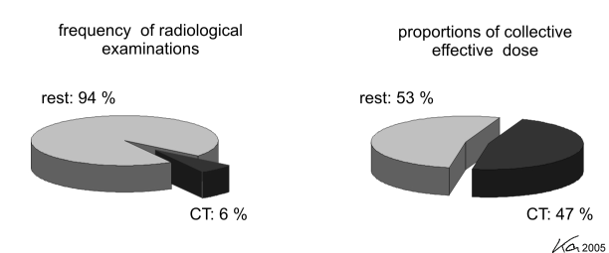
Dose considerations
From Kalender WA, Computed Tomography, ISBN 3-89578-216-5

Slide 43
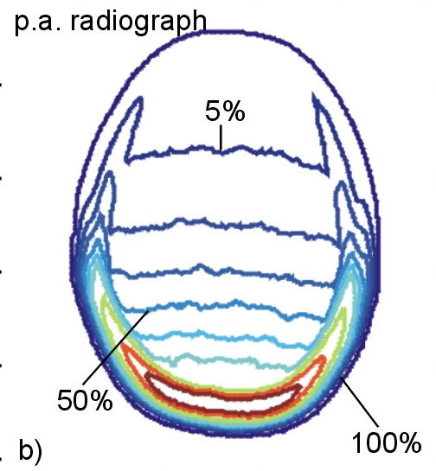
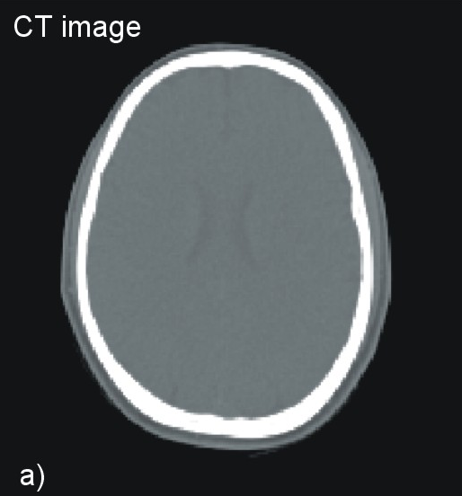
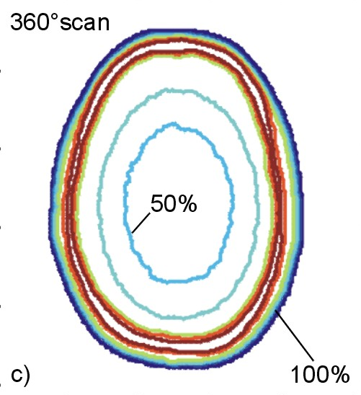
Dose distribution
Projection imaging
Tomographic imaging

Slide 44
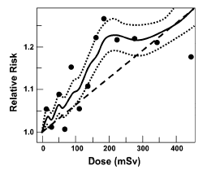
Dose considerations
Incidence of solid cancer (atomic bomb survivors)
Effective dose from 1 CT scan
Brenner DJ et al. 2003. Cancer risks attributable to low doses of ionizing radiation: Assessing what we really know. Proc Natl Acad Sci USA 100(24):13761-6.
Notes:
(caption from paper):
Fig. 4. Estimated risks (relative to an unexposed individual) of solid cancer [incidence] in atomic bomb survivors exposed to low radiation doses (12). Data points are placed at the mean of each dose category. The solid curve represents a weighted moving average of the points shown (dotted curves:1 SE), and the dashed straight line is a linear risk estimate computed from all the data in the dose range from 0 to 2,000 mSv. Age-specific cancer rates from 1958 to 1994 are used, averaged over follow-up and gender.
CT scan dose estimate from [Brenner and Elliston 2004. Estimated radiation risks potentially associated with full-body CT screening. Radiology 232:735-8.]

Slide 45
Dose considerations
Atomic bomb survivors vs. nuclear workers
Atomic bomb survivors Nuclear workers
(Preston et al. 2003) (Cardis et al. 2005)
Mean dose 20 mSv (colon) 20 mSv (colon)
ERR solid cancer 0.93/Sv 0.87/Sv
ERR: Excess Relative Risk
Notes:
The estimate for the full cohort of atomic bomb survivors is 0.47/Sv
The low-dose atomic bomb survivors number roughly 50,000. There were 29,873 people in the extended Techa River cohort and 407,391 workers in the 15-country study.

Slide 46
Dose considerations
Gender and age differences
3
2
ERR/Sv
1
0
0-9
10-19
20-39
40+
age at exposure (years)
male
female
Notes:
This graph shows the relative risk of solid cancer incidence in the atomic bomb survivors (Thompson et al. 1994).
BEIR VII and other major reviews of the effects of radiation note that women appear to have a higher relative risk of cancer for many types of cancer than men.
Many cohorts are not able to address this difference very well because they include mostly men or mostly women (nuclear workers, studies of breast cancer).
The atomic bomb survivors were a general population. Another general population was the cohort of residents near the Mayak facility in Russia.
Among the atomic bomb survivors there was a clear difference between men and women in the relative risk. At the same time, background risks were twice as high for men. This means that approximately equal numbers of cancers were estimated to have been caused by radiation in men and in women. Leukemia risks were not significantly different among the atomic bomb survivors.
The figure in this slide is Figure 4-5 from the Overview. Table 4-1 provides more tumor-specific detail.

Slide 47
Dose considerations
Health effects
- Radiation increases the risk of cancer and other diseases
- There is no “safe” dose of radiation
- Risk is related to dose
- Women and children are more sensitive to radiation than men

Slide 48
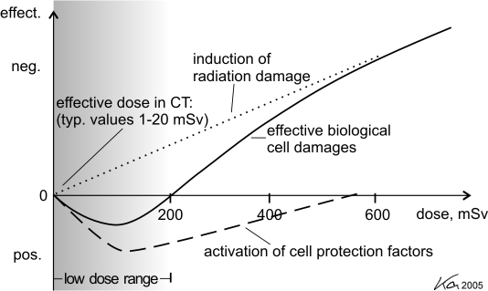
Dose considerations
CT vendor’s view
From Kalender WA, Computed Tomography, ISBN 3-89578-216-5

Slide 49
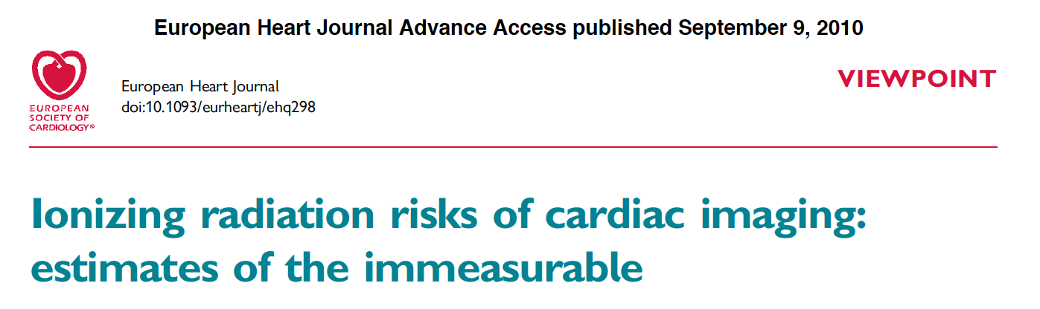
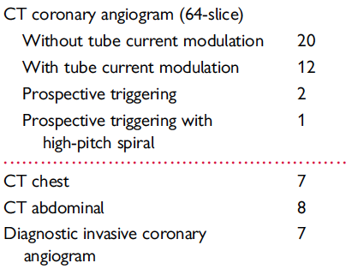
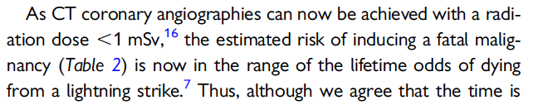
Dose considerations
Scientific literature

Slide 50
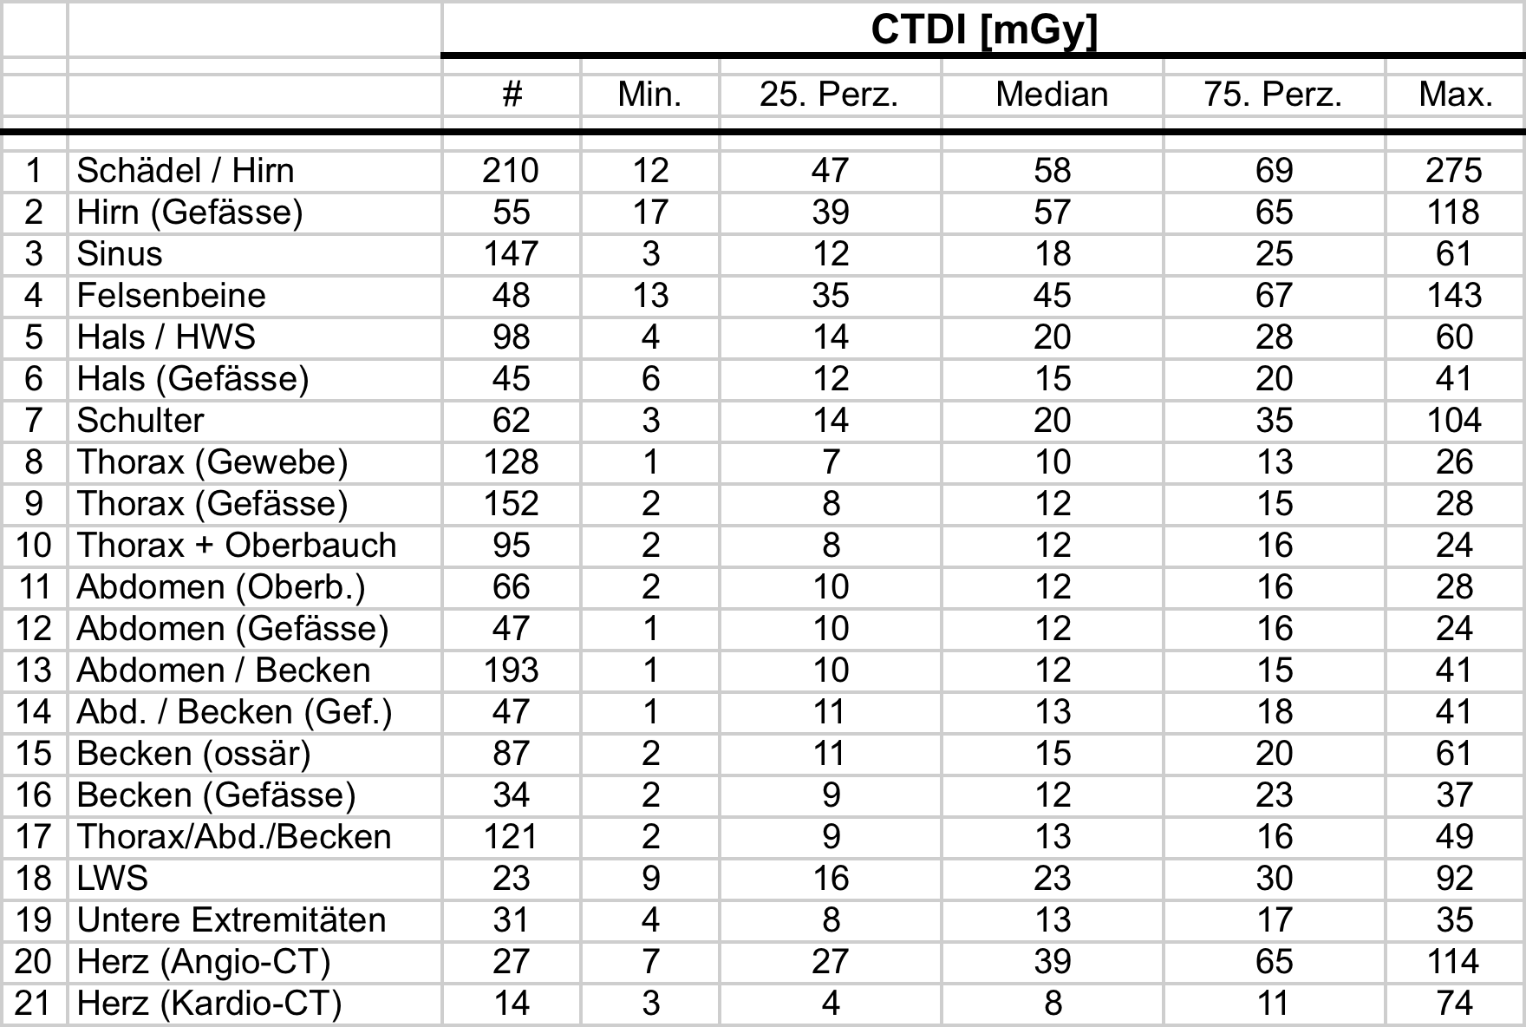
Dose considerations
Swiss Federal Office for Public Health (BAG data 2010)

Slide 51
Dose considerations
Swiss Federal Office for Public Health (1998-2014)
Number CT exams in Switzerland
810k
250k
1998
2014

Slide 52
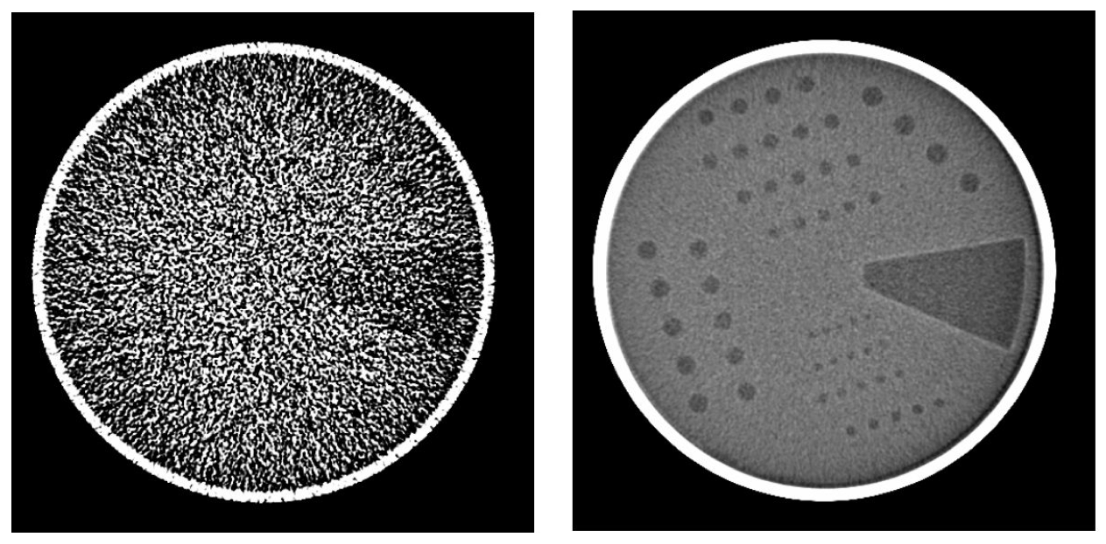
Clicker Activity (5 min)
If the product of tube-current and scan time doubles, the signal-to-noise ratio (SNR) of a CT image
• is increased by a factor of 2
• is increased by a factor of sqrt(2)
• remains unchanged
• is reduced by a factor 2
?

Slide 53
Clicker Activity (Notes)
with

Slide 54
Biomedical Imaging
Imaging Mode: X-ray Imaging
Probe: X-ray photons
Wavelength: 10 pm – 10 nm
Matter interaction: absorption, scatter
Modalities: Projection imaging Digital Subtraction Angiography (DSA) Computed tomography
Resolution: 50 μm – 1 mm
Applications: Mammography, body, neuro, lung, cardiac, angio
Advantages: Very fast, high throughput, 3D
Limitations: Dose, contrast agent, functional information

Slide 55
“The most important slides”

